Slide 1

EMPLOYEE ATTRITION ANALYSIS
AN INTERNSHIP PROJECT OVERVIEW RAJESH NALLIBOYINA
15-04-2025

Slide 2
INTRODUCTION
Objective: Understanding the key factors influencing employee attrition at Green Destinations.
Focus: Identifying trends and suggesting actionable recommendations to reduce turnover.
Methodology: Data analysis, statistical testing, predictive modeling, and visualization.

Slide 3
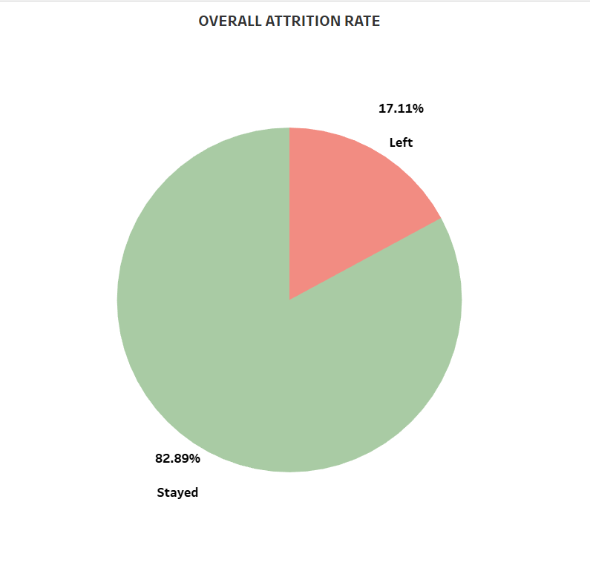
Overall Attrition Rate
Key Insight: Attrition rate of 17.11% is significant, with 1 in 5 employees leaving the company.
Visual: Pie chart showing the split between employees who stayed and those who left.
Stayed: 82.89%
Left: 17.11%
Takeaway: The attrition rate is moderate but could impact productivity and increase recruitment costs.

Slide 4
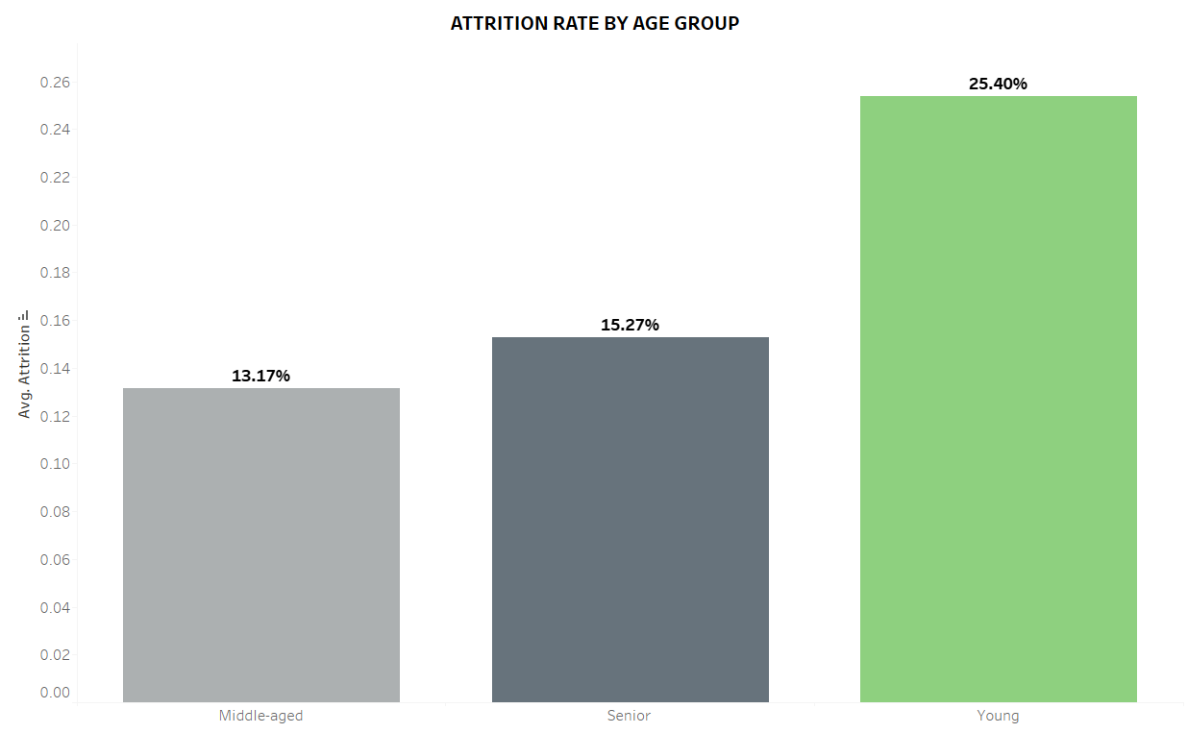
Attrition by Age Group
Key Insight: Younger employees (18-30) exhibit the highest attrition rate (25.40%).
Young: 25.40%
Middle-aged: 13.17%
Senior: 15.27%
Recommendation: Implement targeted retention strategies for younger employees. Consider mentorship programs and career development workshops.

Slide 5
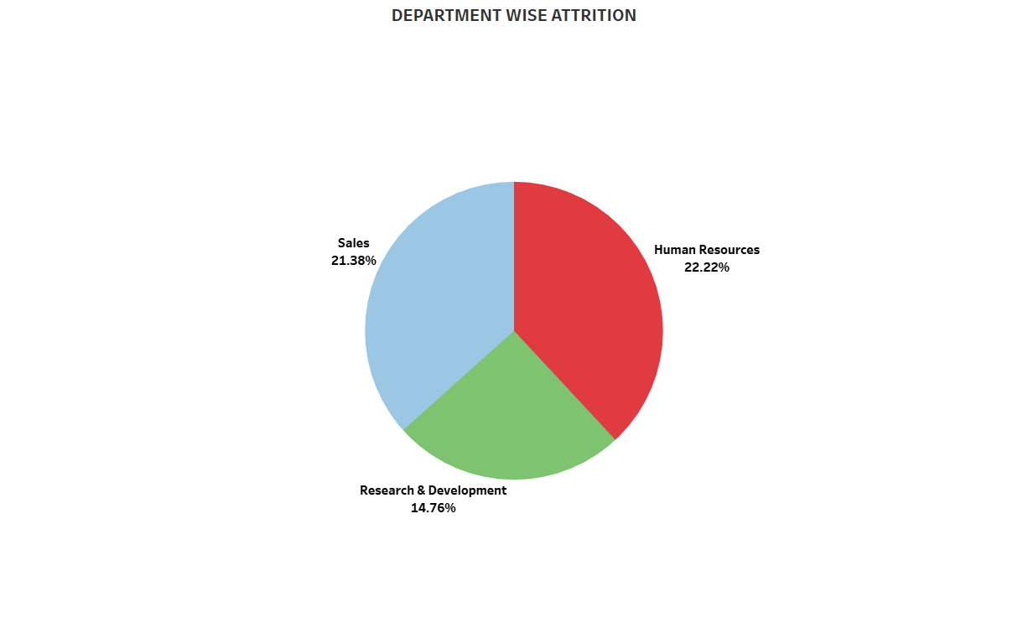
Attrition by Department
Key Insight: High attrition rates observed in Sales (21.38%) and HR (22.22%).
Visual: Pie chart of attrition by department.
Recommendation: Address high-pressure environments in these departments. Offer flexible work arrangements and better team support.

Slide 6
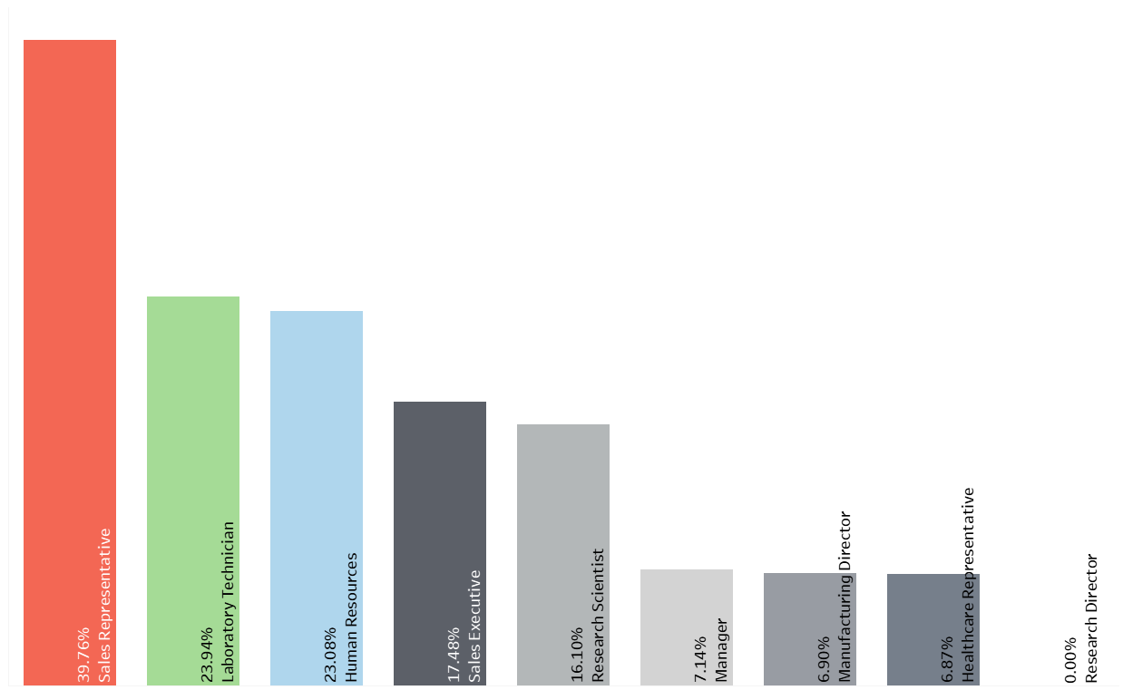
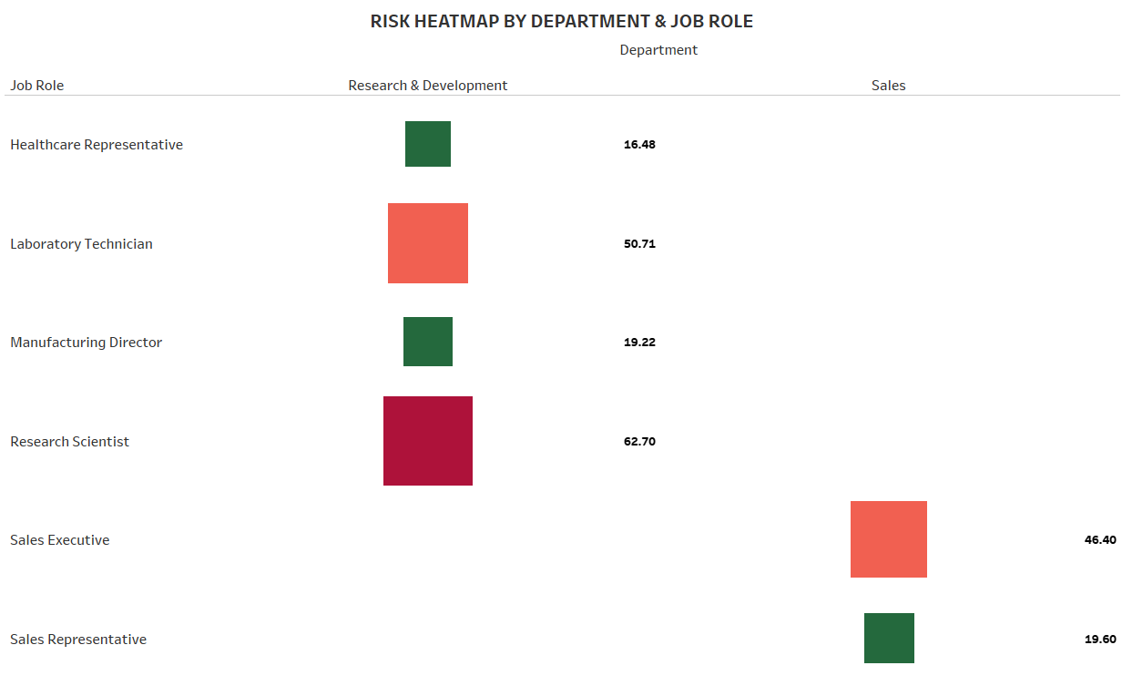
Attrition by Job Role
Key Insight: Research Scientists (62.70%) and Sales Executives (46.40%) have the highest attrition rates.
Recommendation: Focus on improving job satisfaction and workload management for high-risk roles like Research Scientists and Sales Executives.

Slide 7
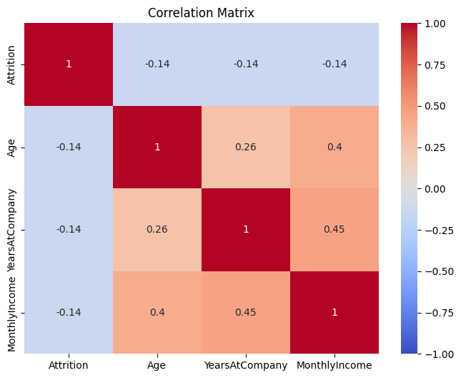
Factors Influencing Attrition
Young employees are more likely to leave (p-value = 0.0000).
Employees with fewer years at the company (3 years vs. 5 years for stayers) are at higher risk (p-value = 0.0000).
Key Insight: Significant factors include age, years at the company, and monthly income.
Lower-paid employees are more likely to leave (p-value = 0.0000).

Slide 8
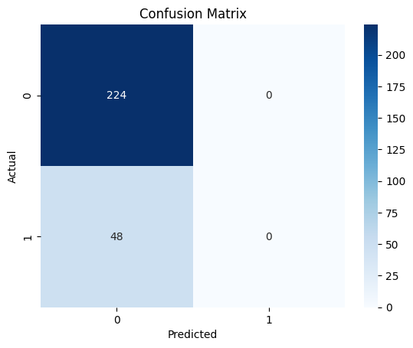
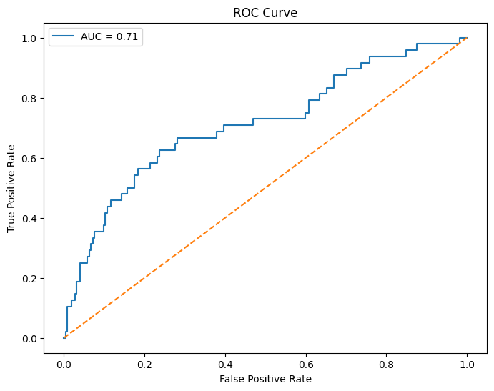
Predictive Modeling
Key Insight: Logistic regression model achieved an accuracy of 83.82% in predicting attrition.
Visual: Confusion matrix and ROC curve.
Takeaway: Overtime, job satisfaction, and work-life balance are critical predictors.

Slide 9
Recommendations to Reduce Attrition
For High-Risk Groups:
Young employees: Mentorship, career development.
Sales and HR: Flexible work arrangements, better incentives.
Research Scientists: Recognition, career growth opportunities.
Focus on Non-Monetary Factors:
Reduce overtime. Offer compensatory time off.
Improve job satisfaction and work-life balance through wellness programs and surveys.
Learn from Low-Attrition Roles:
Research Directors and Manufacturing Directors (0% attrition). Investigate best practices from these roles.

Slide 10
Conclusion
Key Takeaway: Green Destinations can reduce attrition by focusing on younger, newer, and lower-paid employees, improving job satisfaction, reducing overtime, and learning from low-attrition roles.
Future Steps: Implement targeted retention strategies and continuously monitor attrition rates.

Slide 11
